Slide 1
Classifying MRI images of brain tumors using a pre-trained network Resnet18
DATS 6303
Spring 2023
Vinay Bhandaru

Slide 2
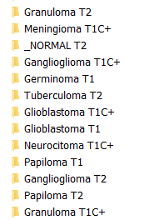
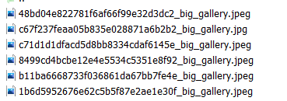
Description of the data set
4479 brain MRI images available on the Kaggle website https://www.kaggle.com/datasets/fernando2rad/brain-tumor-mri-images-44c
The image sizes vary. The first dimension ranges between 347 and 630 pixels and the second dimension ranges between 305 and 630 pixels. 50% of the images have a dimension of 630X630.
There are 44 directories containing images. Each directory corresponds to one of 44 classes and the folder name indicates the class. There are between 17 and 369 images per class.

Slide 3
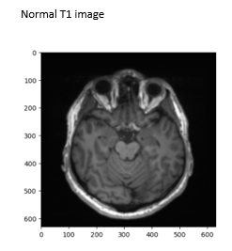
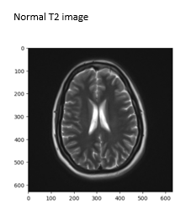
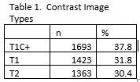
Description of the data set
44 Image classes are based on combinations of 14 tumor types and normal and 3 image contrast types.
3 image contrast types are T1, T1C+, and T2. In T1 images the signal of the fatty tissue is enhanced and the signal of the water is suppressed. In T2 images the signal of the water is enhanced (2)
Another study involving machine learning found classification was worse for T2 images (4).

Slide 4
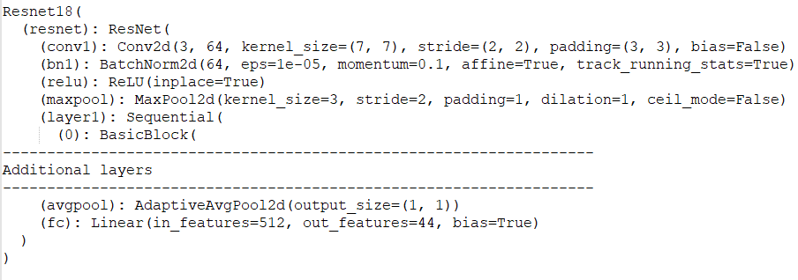
Description of deep learning network and training algorithm
The deep learning network that wae used to classify these images is ResNet-18 from the paper Deep Residual Learning for Image Recognition (7).
The pretrained model and weights are available through Python Pytorch.
models.resnet18(pretrained=True)
It consists of 20 convolutional and batch normalization layers in addition to a max pooling layer and an adaptive average pooling layer.
The only change to the model is the final layer which is a fully connected layer of 44 neurons for 44 classes.

Slide 5
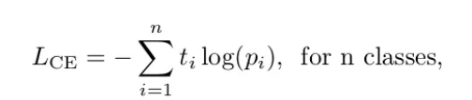
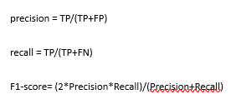
Description of deep learning network and training algorithm
The loss function is the cross entropy loss
The training algorithm is mini-batch gradient descent where the weights and biases are updated after computing the gradient of the loss for a subset of the training set or mini-batch.
Metrics to be used for evaluating trained network is precision, sensitivity, F1

Slide 6
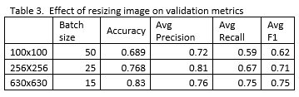
Experimental Setup and Results
The 4479 brain MRI images were split into a training set, consisting of 70% of the images, a validation set consisting of 15% of the images, and a test set consisting of the remaining 15% of the images
The validation set was used to determine the best way to resize the images. 100X100, 256X256, or 630X630
The mini-batch size for larger images was reduced
Accuracy and macro-averaged F1 were highest for 630X630 in the validation, in which none of the image sizes are reduced

Slide 7
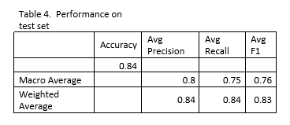
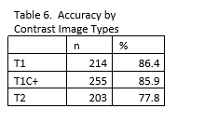
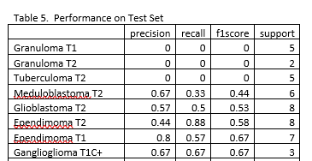
Experimental Setup and Results
Overall accuracy on test set was 84%.
Also, the accuracy for T2 images was lower, consistent with another ML study (4).
Image Classes which had lowest performance are shown in table 5.

Slide 8
Summary and Conclusions
Using a pre-trained Resnet-18 network with only last layer changed achieves nearly 84% accuracy on the test set after resizing images to 630X630.
Reducing image size to 256x256 or lower results in a poorer performing model
The highest accuracy is for T1 images at 86.4% and T1C+ images at 85.9%. T2 images had a lower accuracy at 77.8%.
Improvements might be possible with image augmentation to deal with unbalanced number of images per class or other approaches like generative adversarial networks.

Slide 9
References
https://www.kaggle.com/datasets/fernando2rad/brain-tumor-mri-images-44c
Kawahara D, Nagata Y. T1-weighted and T2-weighted MRI image synthesis with convolutional generative adversarial networks. Rep Pract Oncol Radiother. 2021 Feb 25;26(1):35-42. doi: 10.5603/RPOR.a2021.0005. PMID: 33948300; PMCID: PMC8086713.
https://www.mayoclinic.org/diseases-conditions/meningioma/
Alves AFF, Miranda JRA, Reis F, de Souza SAS, Alves LLR, Feitoza LM, de Castro JTS, de Pina DR. Inflammatory lesions and brain tumors: is it possible to differentiate them based on texture features in magnetic resonance imaging? J Venom Anim Toxins Incl Trop Dis. 2020 Sep 4;26:e20200011. doi: 10.1590/1678-9199-JVATITD-2020-0011. PMID: 32952531; PMCID: PMC7473508.
https://towardsdatascience.com/a-look-at-precision-recall-and-f1-score-36b5fd0dd3ec
https://pytorch.org/docs
He, Kaiming & Zhang, Xiangyu & Ren, Shaoqing & Sun, Jian. (2016). Deep Residual Learning for Image Recognition. 770-778. 10.1109/CVPR.2016.90.

